Slide 1
2021 State of Snacking Insights
1

Slide 2
Key Points
25% snacking more frequently → +5pts vs 2016
On average, consumer eat 2.7 snacks/day
66% snack for enjoyment → +7 pts vs 2019
49% snack to satisfy hunger → +2 pts vs 2019
Ready to eat cereal grew +9% vs 2019
Wellness has a 27% $ share and grew +5% vs 2019
63% of consumers state that brand choice is important when choosing snacks → +3pts vs 2019
37% of consumers are influenced at checkout
54% want indulgent snacks at checkout → +1 pt vs 2019
53% want healthy snacks at checkout → +5 pts vs 2019
56% of consumers want snacks with additional health benefits
40% of consumers state that snacks they eat help manage their daily calories
52% of consumers wants snacks that can be eaten on-the-go
17% of consumers are buying larger sized packages → +2 pts vs 2018
60% of consumers state that premium snacks are worth paying extra
70% of consumers wants snacks that have premium flavors and quality
24% of consumers switched to baking snack bars instead of buying them
Source: IRI How American Eats: The Snacking Frenzy in 2021 & Beyond
*Internal use only
2

Slide 3
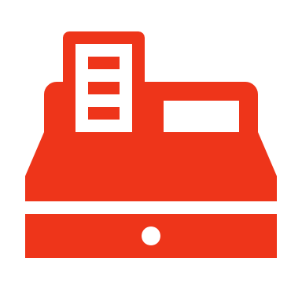
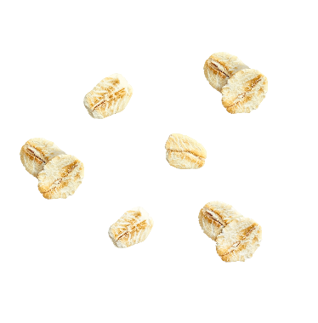
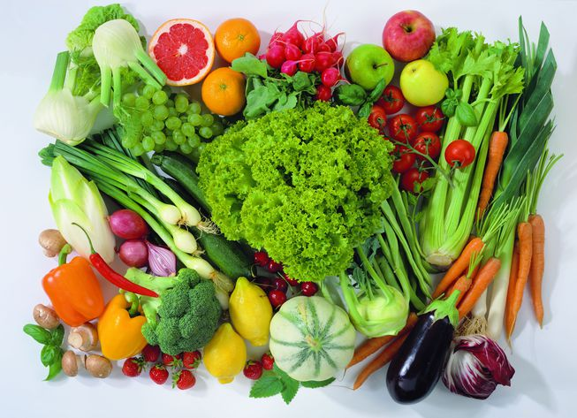


The Importance of Healthy Options at the Front End
Snacking is a Huge Opportunity for Connecting with Consumers
Checkout Influences Consumers Buying Decisions
Consumers are consuming 2.7 snack/day
37%
of consumers are influenced at checkout
25%
+5
of U.S Adults are Snacking More Frequently
Points vs. 2016
Consumers are Looking for Healthy Options when Snacking
Bars in the Front End are a Win-Win for Consumers & the Category
51% of consumers eat more bars because they’re a healthier option¹
56%
of consumers want snacks that have additional health benefits
53%
+5
of consumers look for healthy snacks at checkout
Points vs. 2019
Source: IRI How American Eats: The Snacking Frenzy in 2021 & Beyond
Source 1: Mintel Snack, Performance, and Nutrition Bars – March 2021
*Base: 420 internet users aged 18+ who have increased bar consumption
3

Slide 4
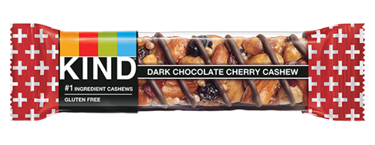
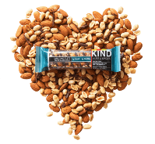
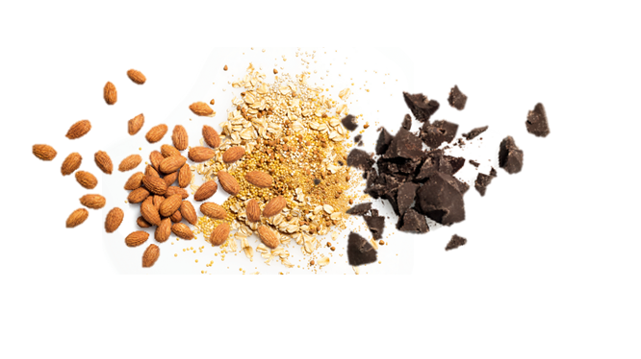
Consumers are looking for healthy, premium snacks
Consumers want healthy snacks
And expect premium quality from them
56%
70%
of consumers want snacks with additional health benefits
of consumers want snacks of premium quality and flavors
KIND’s Promise is Giving Consumers What They Want…
Guardrail #1
Convenient
Guardrail #2
Healthy & Tasty
Guardrail #3
Real
Makes eating healthy easier
Created for convenience
Nutrient rich ingredients
Minimal sugar
Uncompromisingly Delicious
Ingredients you can see and pronounce®
No artificial sweeteners, preservatives, colors or flavors
Source: IRI How American Eats: The Snacking Frenzy in 2021 & Beyond
4

Slide 5

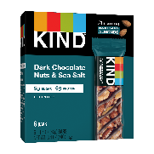
Consumers are buying larger pack sizes since the impact of COVID
Consumers want larger pack sizes
Core Snack Multipacks
17%
+2
+10%
of consumers are buying larger sized packages of snacks¹
$ % Chg. vs. YA
Points vs. 2018
+2pts
+5pts
+4pts
Source 1: IRI How American Eats: The Snacking Frenzy in 2021 & Beyond
Source 2: IRI KIND Energy Nutrition Total US MULO Data Ending 3.21.21
*Core Snack Multipacks = 2+ count
6

Slide 6



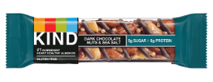
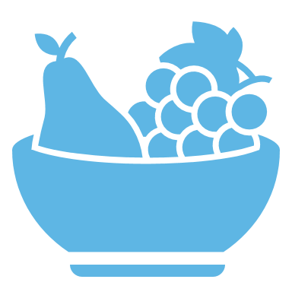
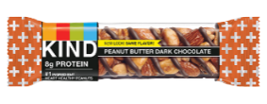
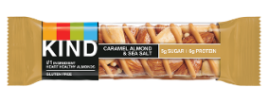
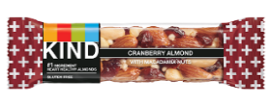
With an uptick in healthier eating, KIND bars are a great option for consumers
COVID impacted consumers eating
KIND bars are the perfect healthy snack!
42%
of US adults have made healthier eating a higher priority due to COVID-19
51%
of consumers increased bar consumption because they’re a healthier option¹
Healthier eating is on the rise
Nutrient rich ingredients
Minimal sugar
Ingredients you can see and pronounce
No artificial sweeteners, preservatives, colors or flavors
56%
of consumers want snacks with additional health benefits
Source: IRI How American Eats: The Snacking Frenzy in 2021 & Beyond
Source 1: Mintel Snack, Nutrition, and Performance Bars March 2021
Q: Why are you eating more snack, nutrition, or performance bars this year than last year? Please select all that apply.
5

Slide 7
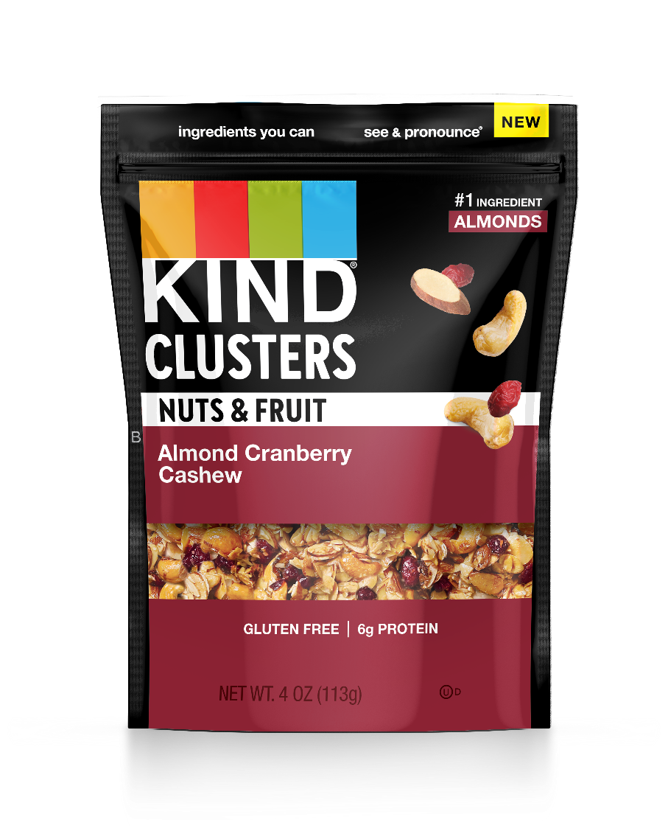
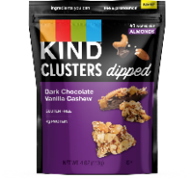
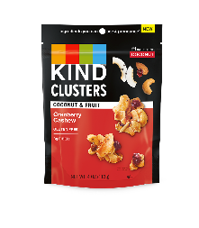
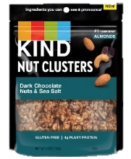


Younger Generations snack throughout the day and KIND Snacks are a great solution
2.7
Average Number of Snacks Consumed Daily
25%
Snack More Frequently
+5 pt vs 2016
Classic KIND Flavors
Nuts & Fruit
Clusters Dipped & Coconut Clusters
Source: IRI How American Eats: The Snacking Frenzy in 2021 & Beyond
7

Slide 8



Bars are eaten all throughout the day, most popular for breakfast
Bar Consumption Occasions
Source: Mintel Snack, Nutrition, and Performance Bars March 2021
Q: During which of the following occasions do you eat snack, nutrition, or performance bars? Please select all that apply.
8

Slide 9
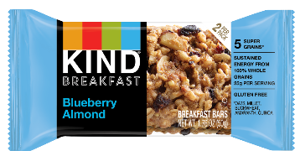
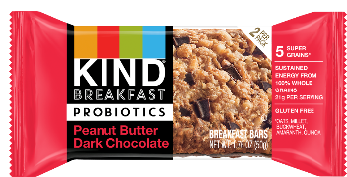
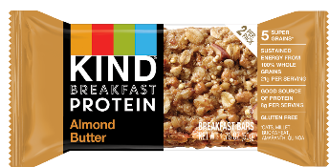
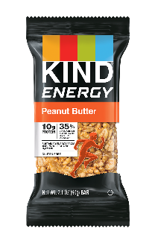
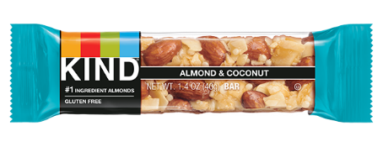
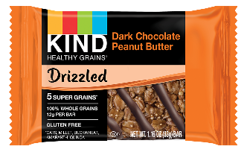
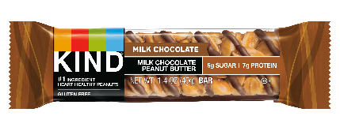
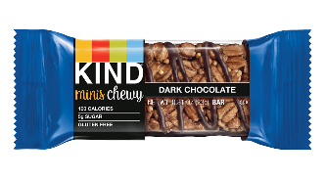
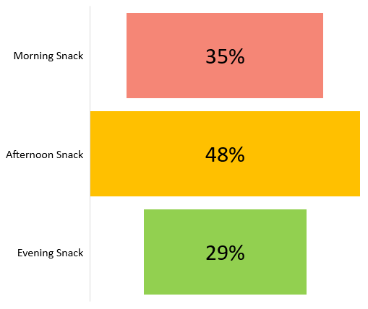
Consumers snack on bars throughout the day, but primarily in the afternoon
Bar Consumption Occasions as Snacks
Source: Mintel Snack, Nutrition, and Performance Bars March 2021
Q: During which of the following occasions do you eat snack, nutrition, or performance bars? Please select all that apply.
9

Slide 10
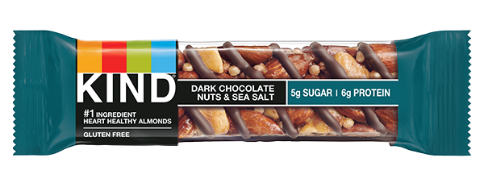
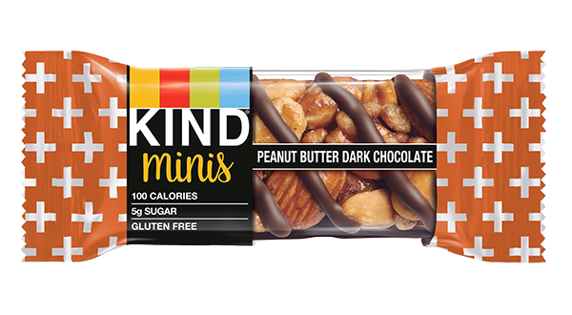
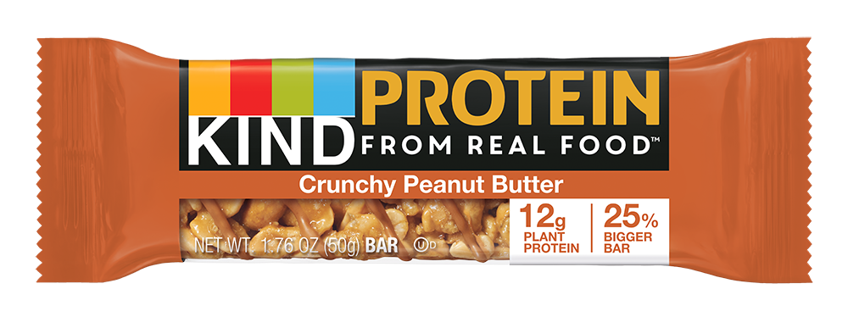

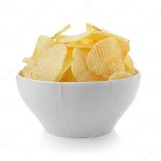
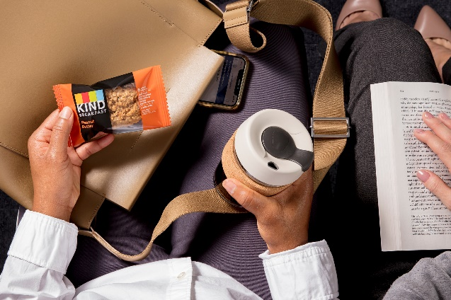




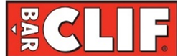
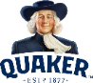
KIND bars are the perfect option for your on-the-go coffee consumer
Consumers look for easy snacks for on-the-go
Bars are the perfect option
Why KIND?
Convenience
is the #1 most expandable brand in the category
52%
Bars are widely seen as portable and convenient snacks
&
the Top Brand to bring in new category buyers⁴
of consumers look for snacks that can be eaten in the car or on the go¹
Bars are the #2 snack only behind salty snacks.²
KIND has incredible brand fundamentals⁵
Bars are eaten all throughout the day!³
Brand | Awareness | Purchased | Purchased Most Often
 | 82% | 48% | 44%
 | 88% | 51% | 39%
 | 81% | 36% | 30%
 | 90% | 40% | 29%
Source 2: KIND Path to Purchase
Source 3: Mintel – Snack Nutrition and Performance Bars – US – March 2021
“During which of the following occasions do you eat snack, nutrition, or performance bars?”
Source 4: IRI disaggregated panel 52 weeks 1) Excludes 1X buyers; 2) Satisfies > 65% SOR with brand
Source 5*Within sample of bar buyers * Total Online Survey respondents = 3,500
Q8. You mentioned that you are aware of these Bar brands: []. Please select all of the Bar brands that you are familiar with, including those that you just mentioned. (Select all that apply.); Q9. You mentioned that you purchased Bars recently. Which brand(s) did you purchase in the past 3 months? (Select all that apply.); Q10. Please select the 3 brands that you purchase the most. (Select three.)
Source 1 : IRI How American Eats: The Snacking Frenzy in 2021 & Beyond
“Look for snacks that can be eaten in the car or on-the-go” ​
10

Slide 11


Protein & Sugar Amounts are key attributes consumers find important within bars
Bar Attributes of Importance
January 2021
Top 2
Attributes
Source: Mintel Snack, Nutrition, and Performance Bars March 2021
Q: Which of the following attributes are important to you when choosing snack, nutrition, performance bars?
11

Slide 12
Over half of consumers are eating more bars because they’re a healthier option
Changes in Bar Consumption
Reasons for Increasing Bar Consumption
January 2021
January 2021
Over 1/3 of Consumers
are eating more bars vs YA
Source: Mintel Snack, Nutrition, and Performance Bars March 2021
Q: How has your snack, nutrition or performance bar consumption changed in comparison to last year
Q: Why are you eating more snack, nutrition, or performance bars this year than last year?
12

Slide 13
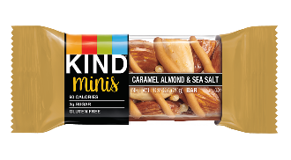
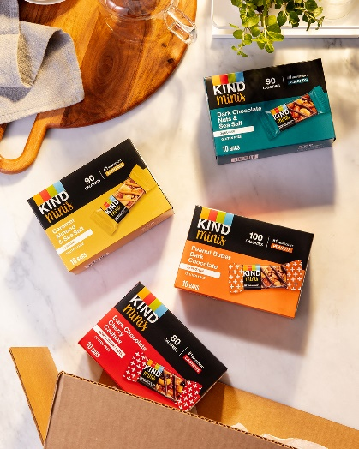
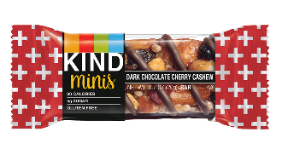
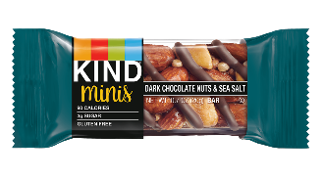
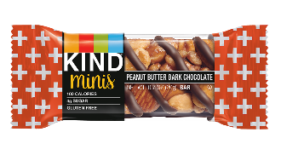
KIND Minis are the perfect option for those following a diet plan
40%
of consumers state that snacks help them manage their daily calories
KIND Minis Offerings
KIND Minis offer what consumers are looking for & more…
Only 80-100 Calories!
#1 Ingredient Nutrient Dense
Gluten Free
Non-GMO
5g Sugar or Less
Source: IRI How American Eats: The Snacking Frenzy in 2021 & Beyond
13

Slide 14

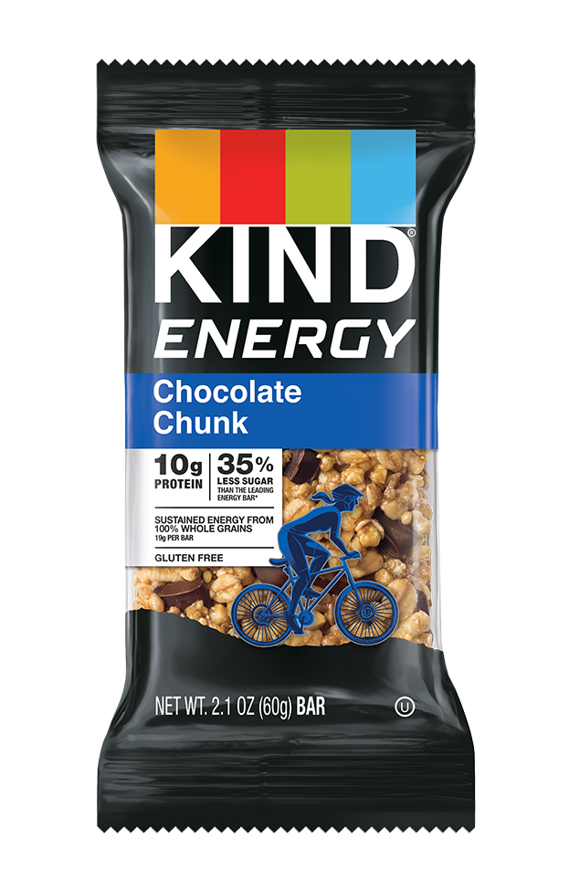
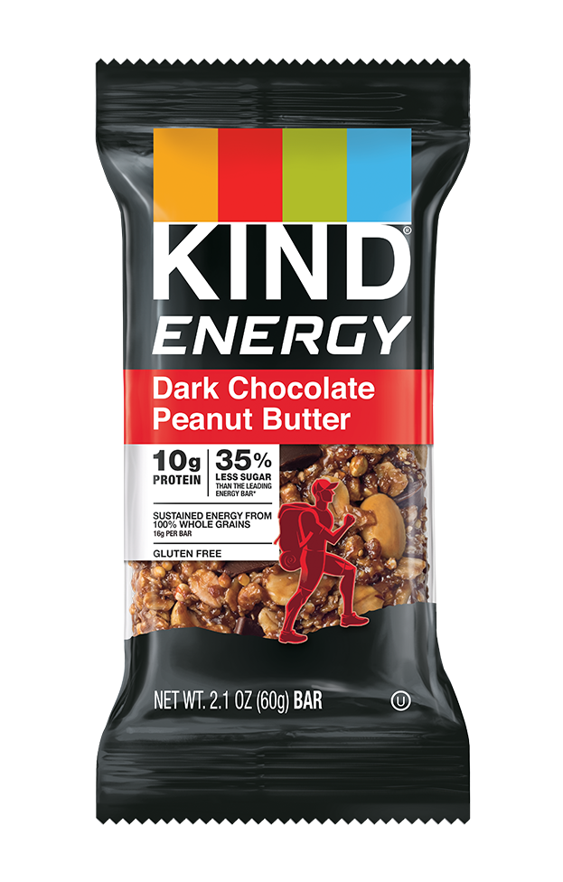
KIND Energy offers consumers an energy boost without the sugar crash
Consumers are looking for healthy energy in bars
KIND Energy…
34%
of consumers state they want bars with an energy boost
Peanut Butter
Chocolate Chunk
Dark Chocolate Peanut Butter
Consumers interest in fiber content has have seen +5% growth v. 2019
Sustained energy from Whole Grains
Has 5g of fiber
Has 35% less sugar than the leading energy bar brand
45%
of consumers believe sugar amount is most important when choosing bars
Source: Mintel Snack, Nutrition, and Performance Bars March 2021
14

Slide 15
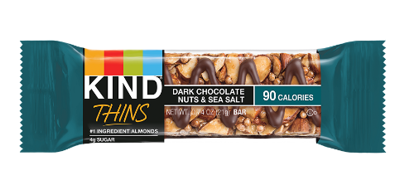
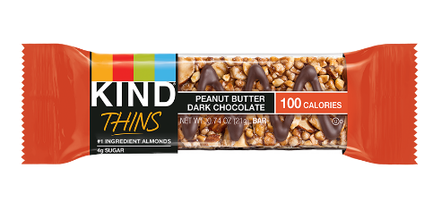
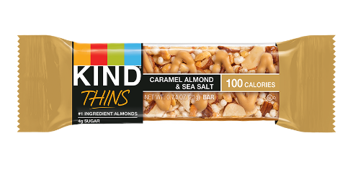
KIND Thins are the perfect option for those who want a light, premium snack
40%
of consumers state that snacks help them manage their daily calories
70%
of consumers wants snacks that have premium flavors and premium quality
KIND Thins Offerings
KIND Thins offer what consumers are looking for & more…
Only 100 Calories or Less!
#1 Ingredient Almonds
Chocolate/Caramel Drizzle for a Rich and Indulgent Experience
4g Sugar
Source: IRI How American Eats: The Snacking Frenzy in 2021 & Beyond
15

Slide 16
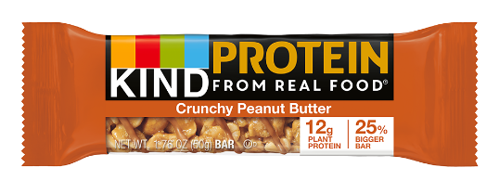
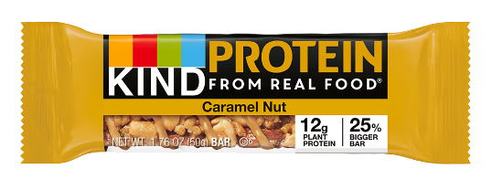
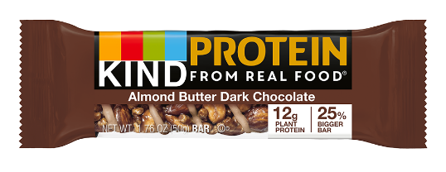
KIND Protein offers consumers the right amount of protein with low sugar content
Consumers are looking for high protein in bars
KIND Protein…
56%
of consumers look for 5-14g of protein in their bars
48% of bar consumers believe protein is most important when choosing bars
12g of plant protein
#1 ingredient nutrient dense
8g of sugar per bar
61%
want bars with fewer than 10g of sugar content
Source: Mintel Snack, Nutrition, and Performance Bars March 2021
16

Slide 17
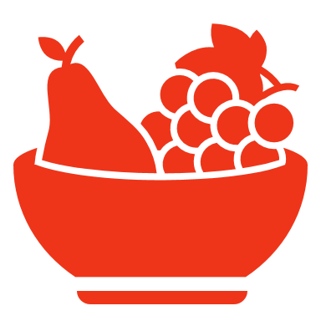






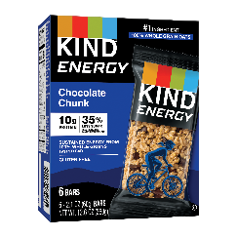
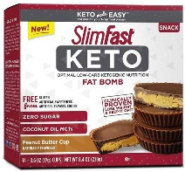
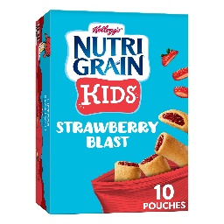
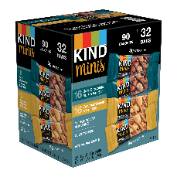










Some innovation themes include nutritional benefits, diet & brand extensions
Innovation Themes in 2021
Nutritional Benefits
Diet Trend
Plant
Based
Dairy Free
Kids
Portion Controlled
Brand Extensions
Energy
Keto
Plant Based
Dairy Free
Kids
Minis
Crossovers
Prebiotics
Paleo
Thins
Source: IRI How American Eats: The Snacking Frenzy in 2021 & Beyond
17

